Slide 1
Lab 5
Chaojie Zhang

Slide 2
HPC workshop 2 next week
Start HW2 early! I will be in the Q&A session next Tuesday.
Modification of HW2 (check campuswire)
Additional reading (not for HW)
Lab5 can be ran on Kaggle, I will post the instructions for running lab5 on Greene

Slide 3

Lab5 Jupyter Notebook
You can run the notebook in Kaggle: https://www.kaggle.com/nih-chest-xrays/sample
Change the paths from the notebook, and use cpu to train.
Metadata path: /kaggle/input/sample/sample_labels.csv

Slide 4
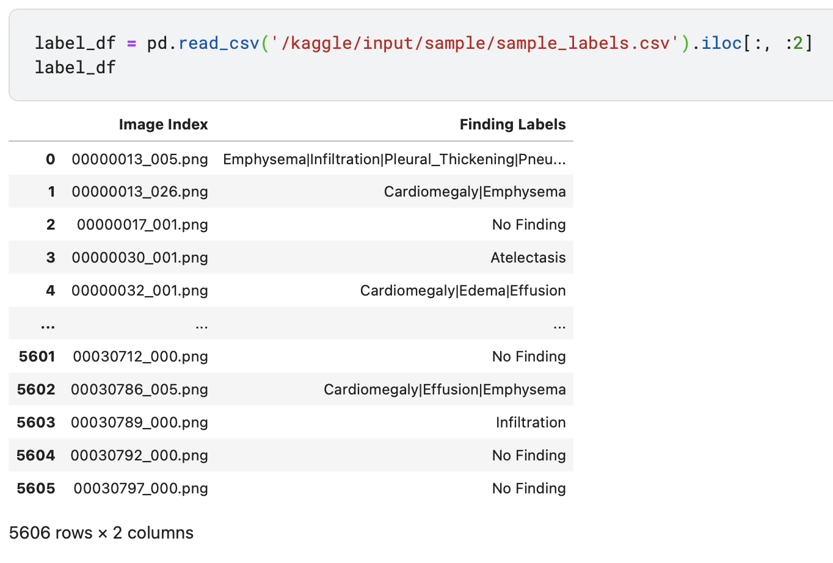
Dataset

Slide 5
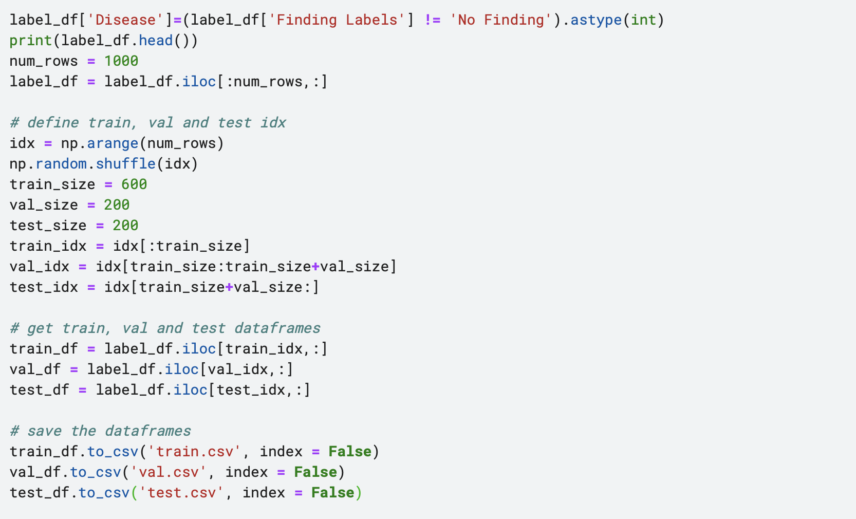
Remove ‘No Finding’ samples
Use only part of the samples (600 train, 200 val, 200 test)

Slide 6
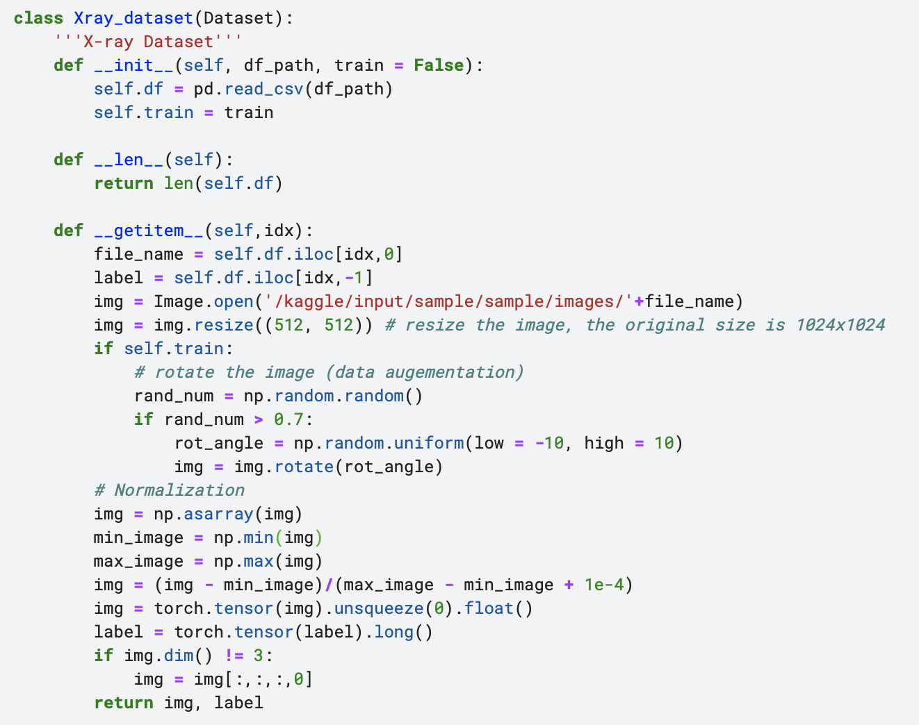
Dataloader

Slide 7
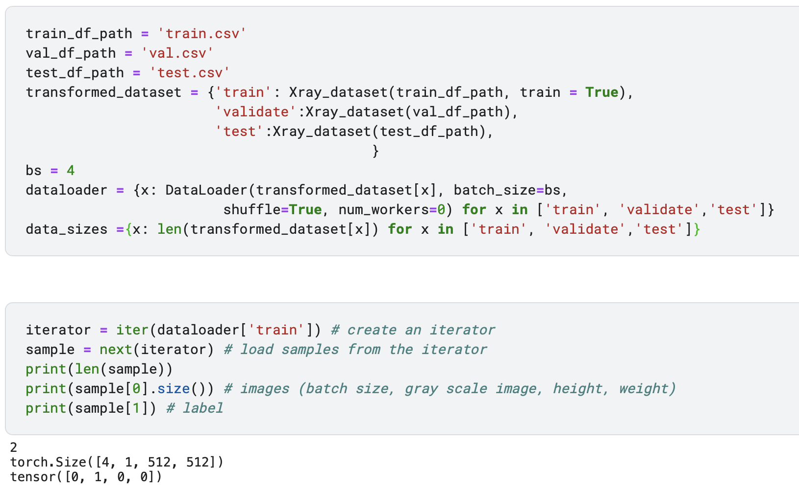
Load samples from the dataloader

Slide 8
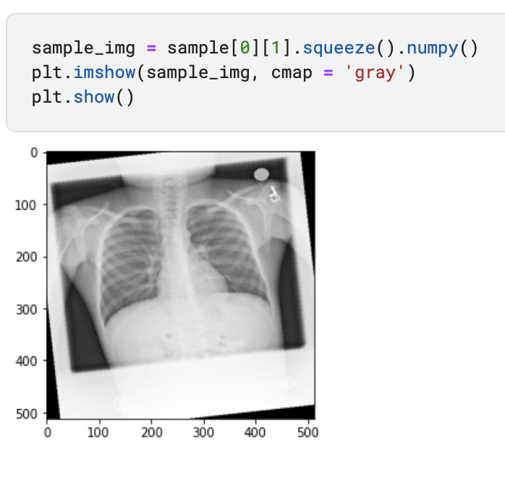
Sample

Slide 9
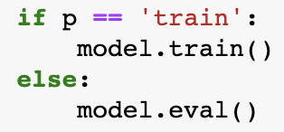
Training Function
model.train() tells your model that you are training the model. So effectively layers like dropout, batchnorm etc. which behave different on the train and test procedures know what is going on and hence can behave accordingly.
https://stackoverflow.com/questions/51433378/what-does-model-train-do-in-pytorch

Slide 10
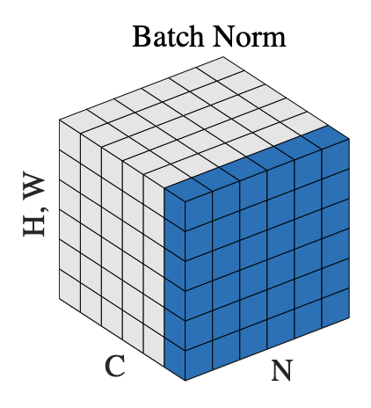

Dropout: https://towardsdatascience.com/machine-learning-part-20-dropout-keras-layers-explained-8c9f6dc4c9ab
Batch Normalization: Normalize among N (batch), H, W, not including C (channel)

Slide 11
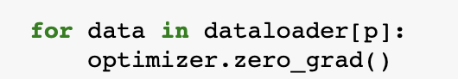
Training Function
For every batch during the training phase, we typically want to explicitly set the gradients to zero before starting to do backpropragation because PyTorch accumulates the gradients on subsequent backward passes.
(Gradients accumulation works in RNN.)

Slide 12
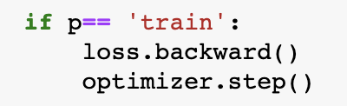
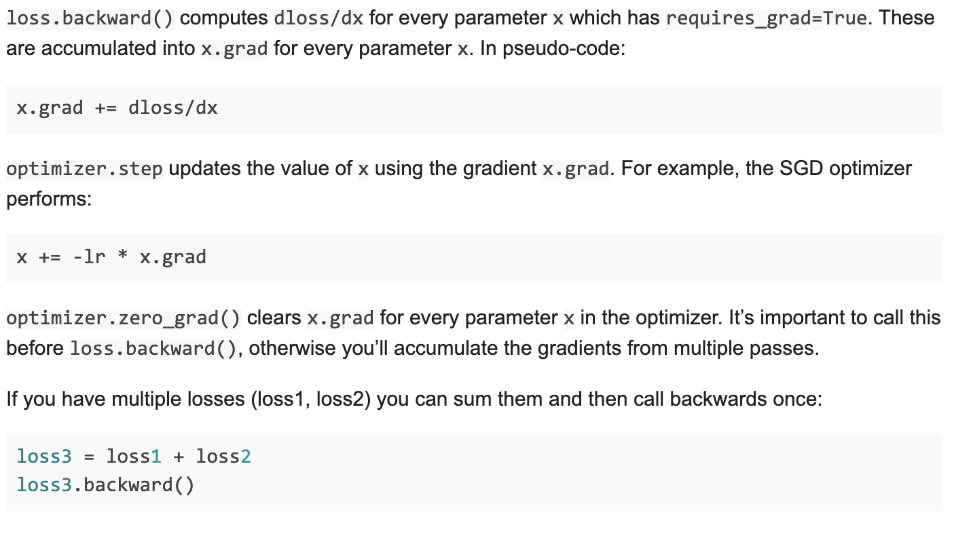
optimizer.step() makes the optimizer iterate over all parameters (tensors) it is supposed to update and use their internally stored grad to update their values.
https://discuss.pytorch.org/t/what-does-the-backward-function-do/9944/2

Slide 13
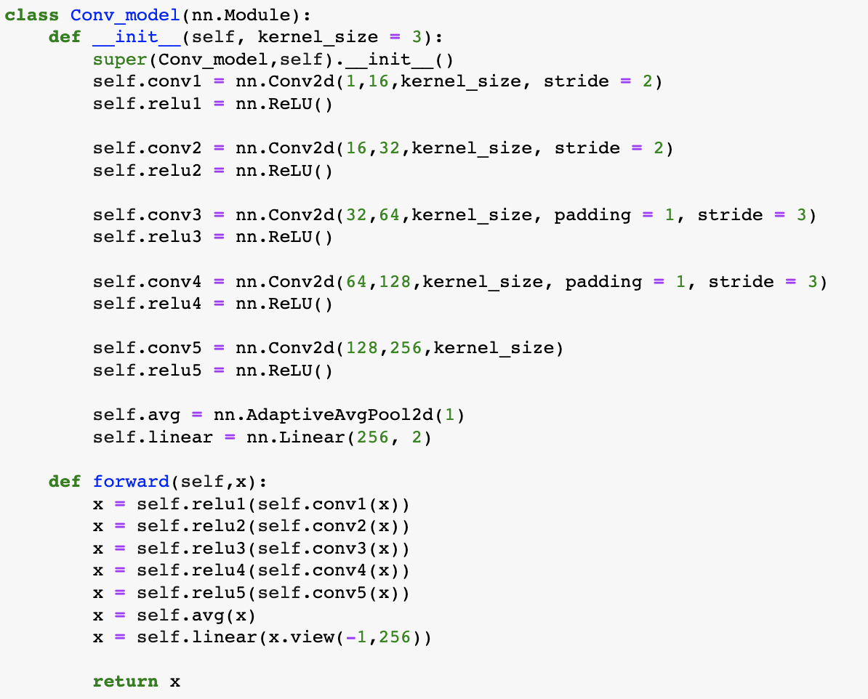
Model

Slide 14
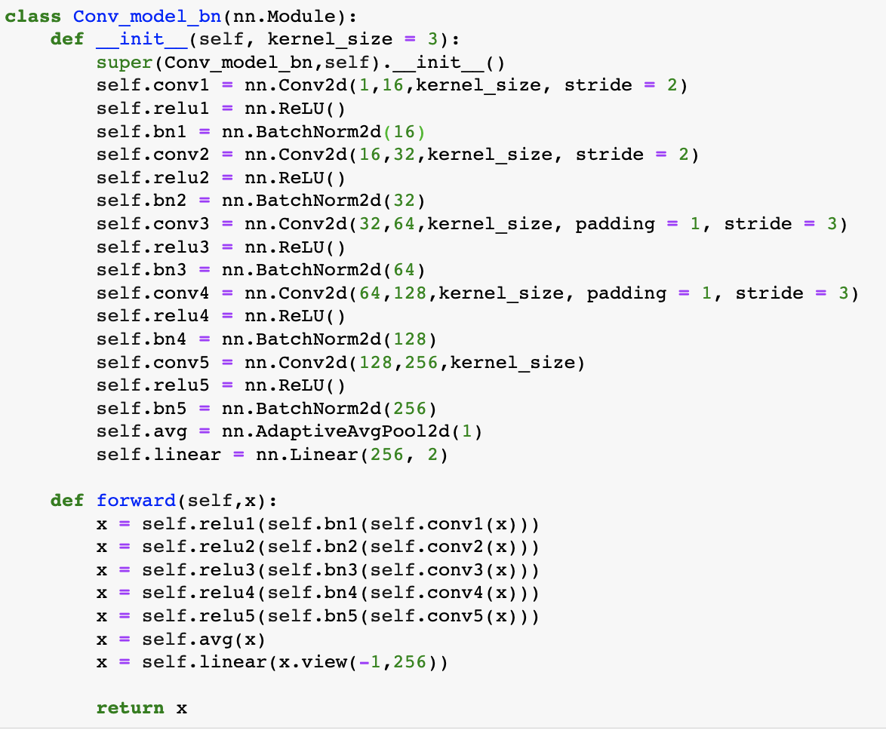
Adding Batch Norms
Without BN: acc = 0.525
With BN: acc =0.55
BN reduced the effect of overfitting.

Slide 15
Projects

Slide 16
Random Seed (reproducible)
def setup_seed(seed):
torch.manual_seed(seed)
torch.cuda.manual_seed_all(seed)
np.random.seed(seed)
random.seed(seed)
torch.backends.cudnn.deterministic = True
setup_seed(0)
device = torch.device('cuda')

Slide 17
Loss
nn.BCELoss: Binary Cross Entropy Loss, you need to add a sigmoid function
nn.BCEWithLogitsLoss: loss combines a Sigmoid layer and the BCELoss
nn.CrossEntropyLoss: Softmax + Cross Entropy Loss, you don’t need to add a softmax function
nn.NLLLoss: Negative Log Likelihood Loss (multiclass cross-entropy), you need to add a softmax function

Slide 18
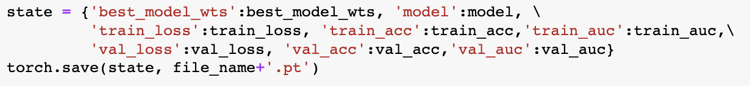
Training
Print the loss, acc, auc in each epoch. Choose the best model (best acc/auc/loss) from the validation set.
Save your model in each epoch, including best weights and current weights.

Slide 19
Reading (not for the HW but important!)
A Recipe for Training Neural Networks
http://karpathy.github.io/2019/04/25/recipe/
Must Know Tips/Tricks in Deep Neural Networks
http://210.28.132.67/weixs/project/CNNTricks/CNNTricks.html
ResNet Structure
http://ethereon.github.io/netscope/#/gist/db945b393d40bfa26006

Slide 20
From Attention to Vision Transformer
Reference: https://github.com/wangshusen/DeepLearning

Slide 21
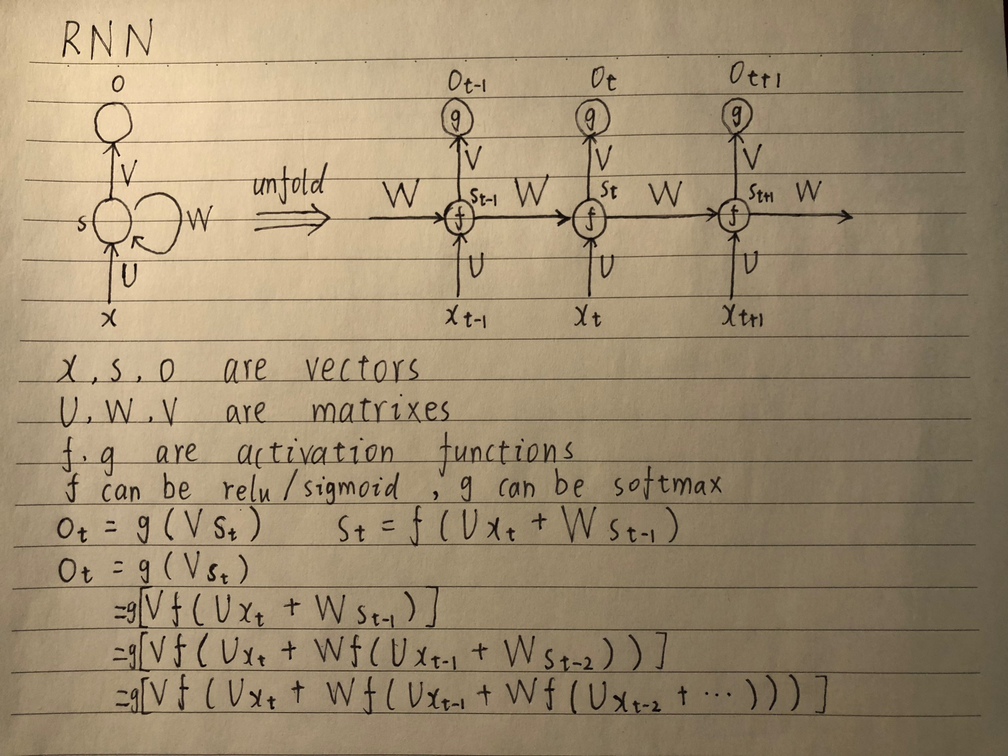

Slide 22
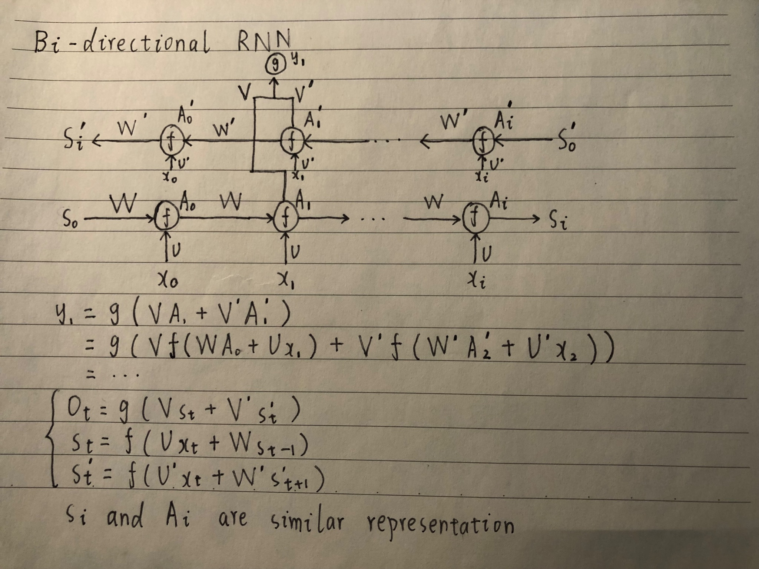

Slide 23
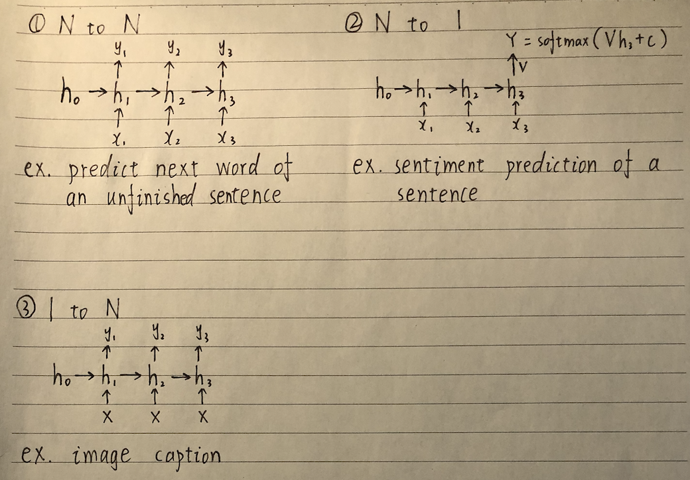

Slide 24
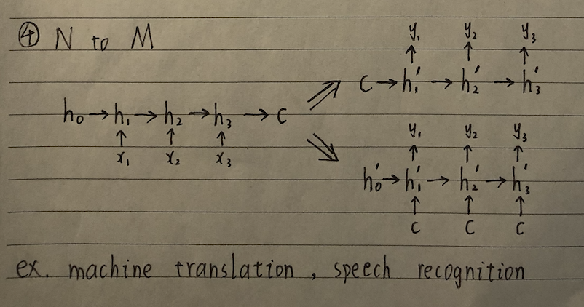

Slide 25
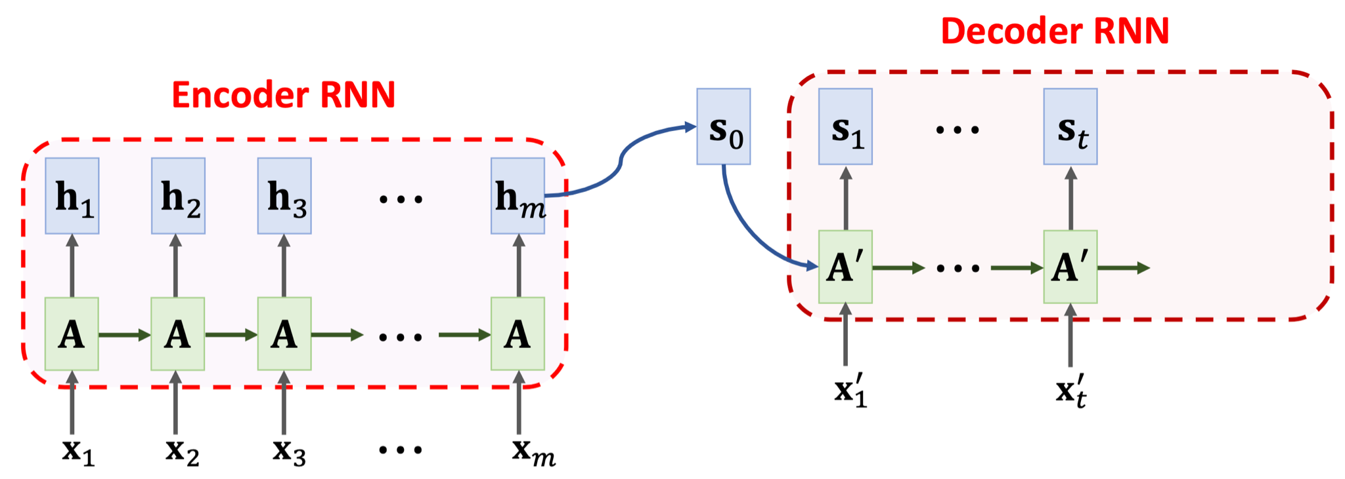
Seq2Seq Model
The final state is incapable of remembering a long sequence.

Slide 26
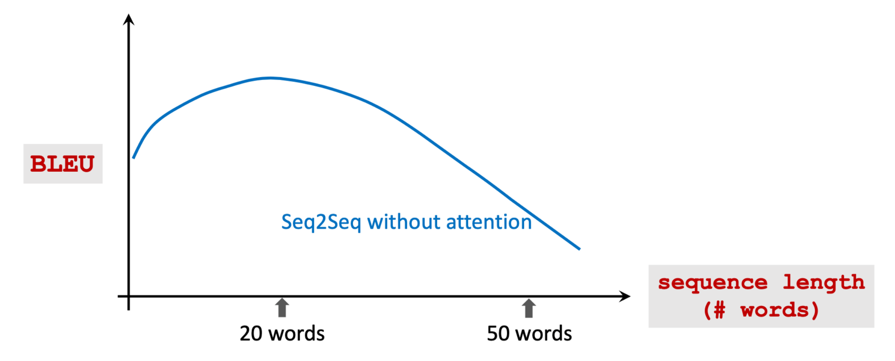

Slide 27
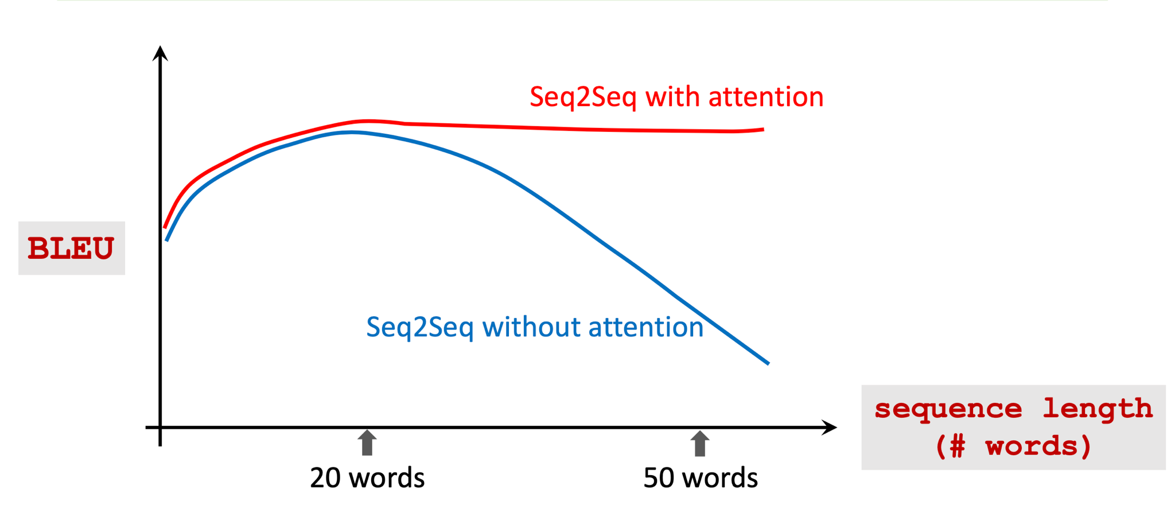

Slide 28
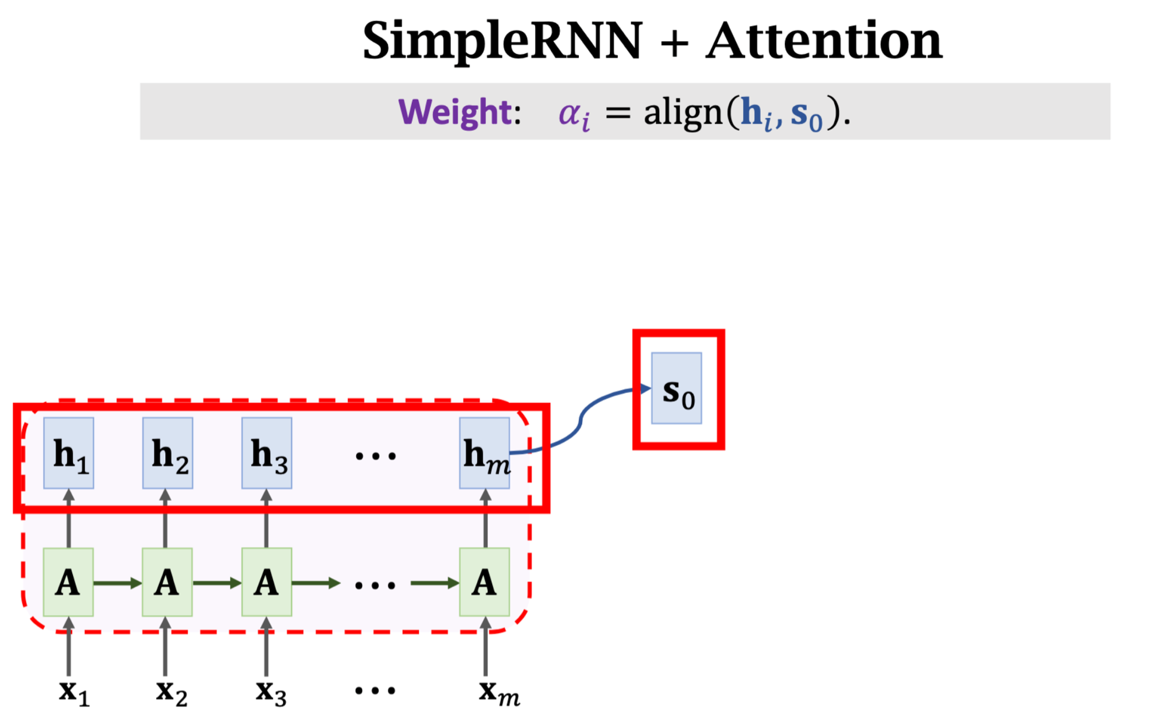

Slide 29
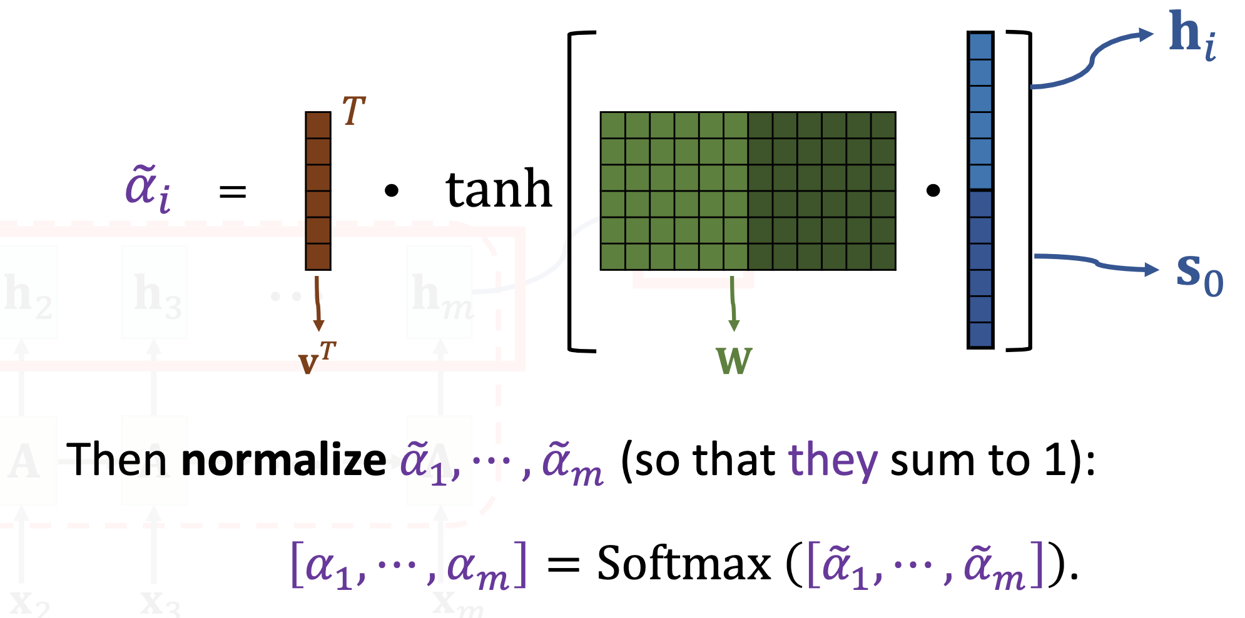
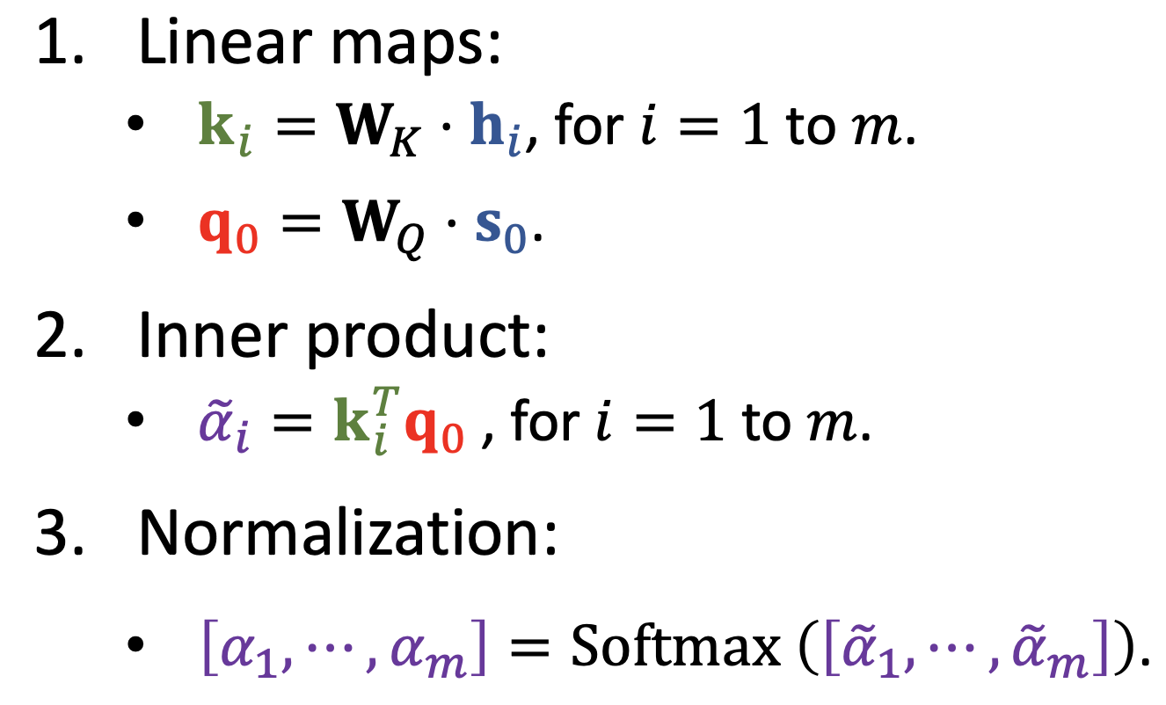
align()
Option 1 (used in the attention paper)
Option 2 (used in the Transformer)

Slide 30
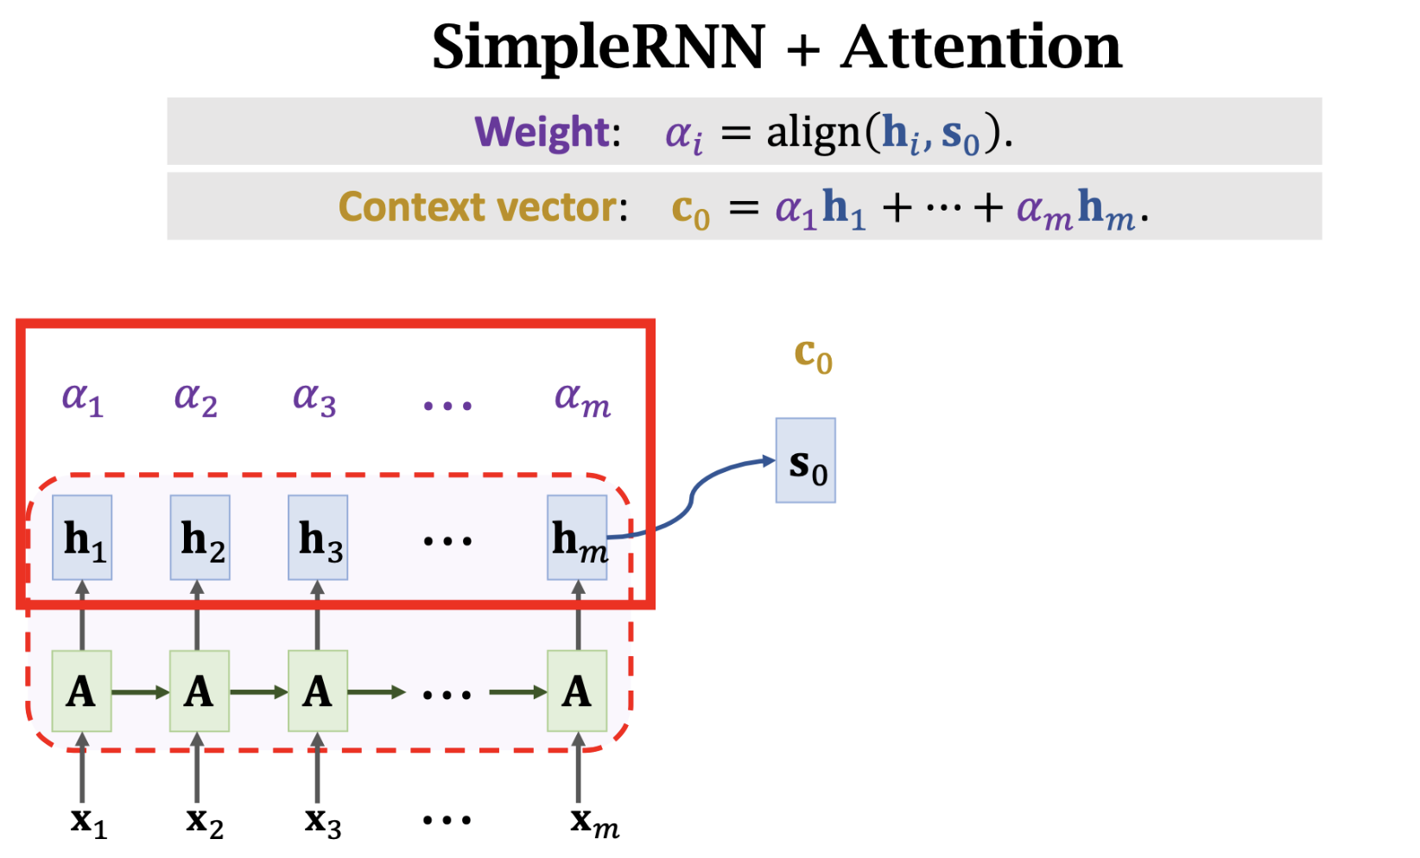

Slide 31
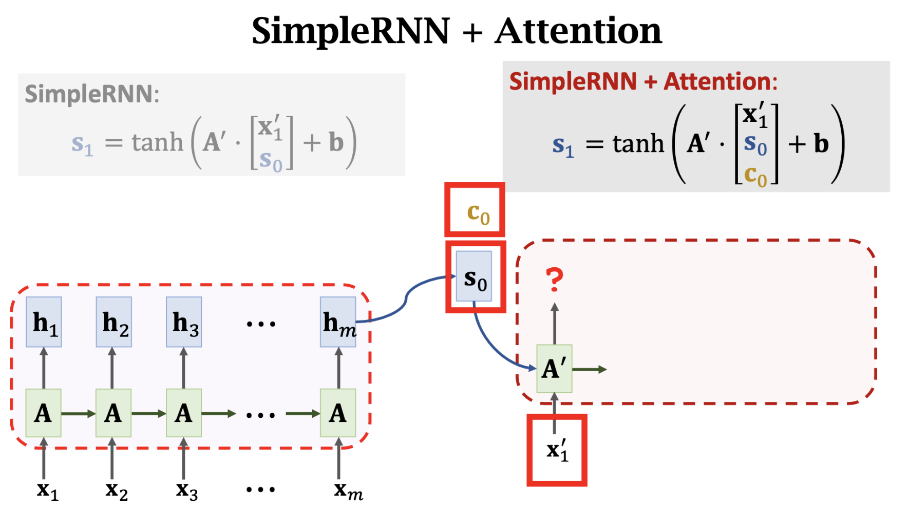

Slide 32
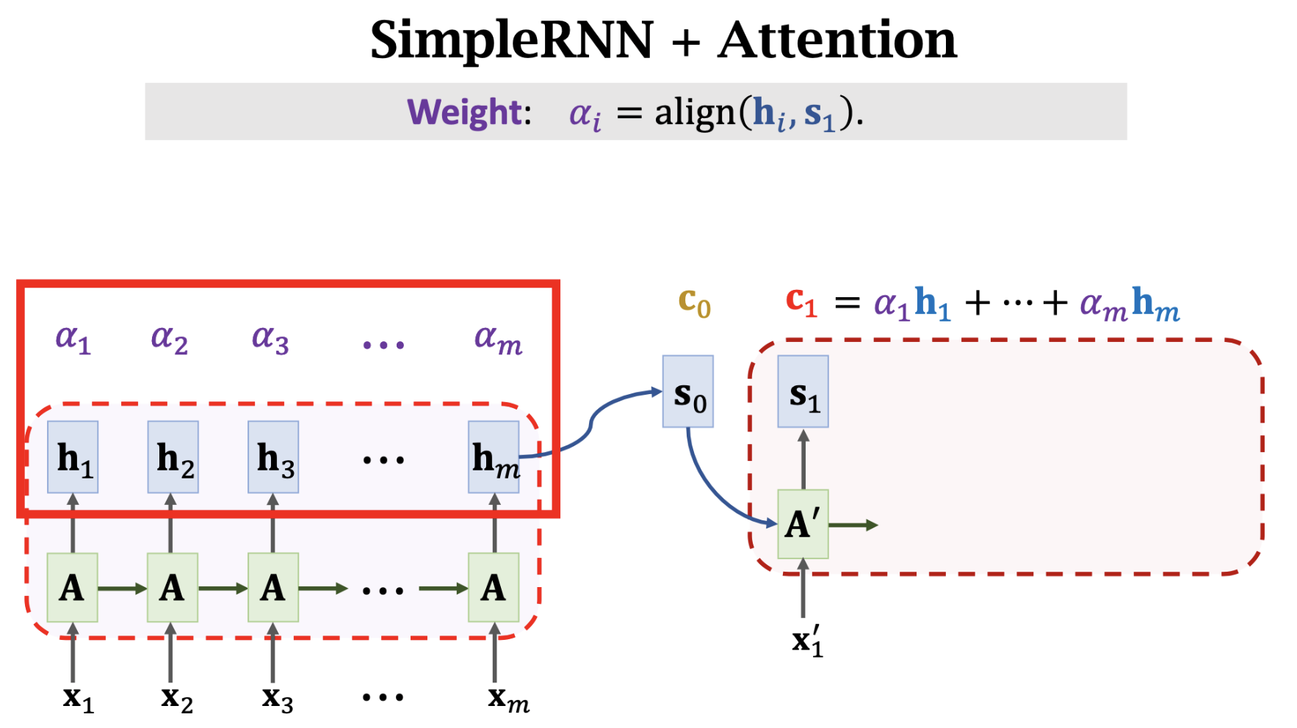
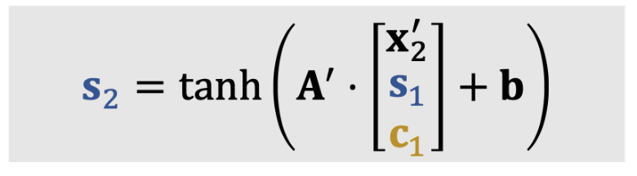

Slide 33
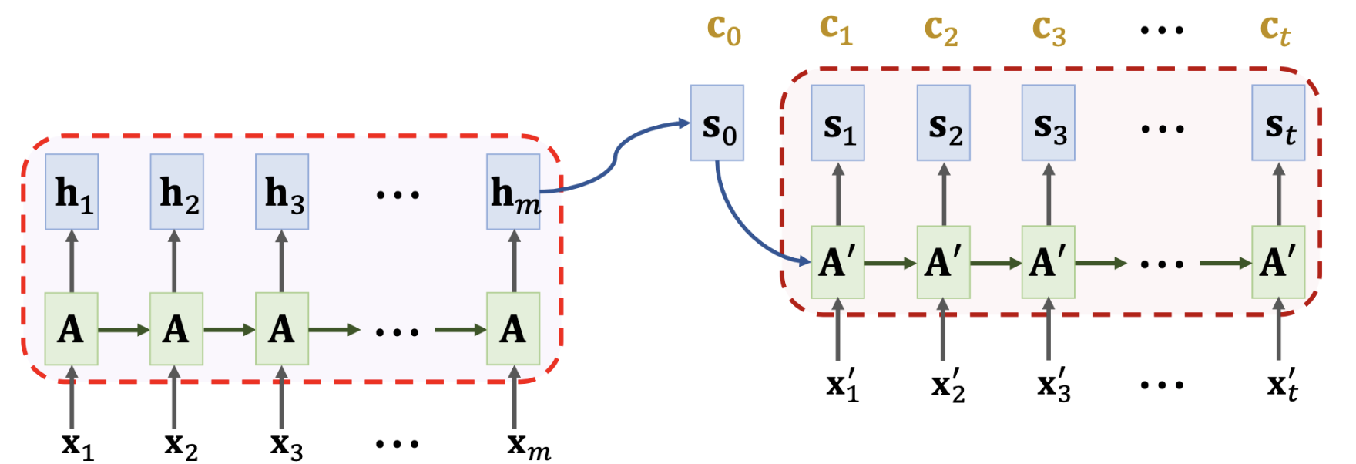

Slide 34
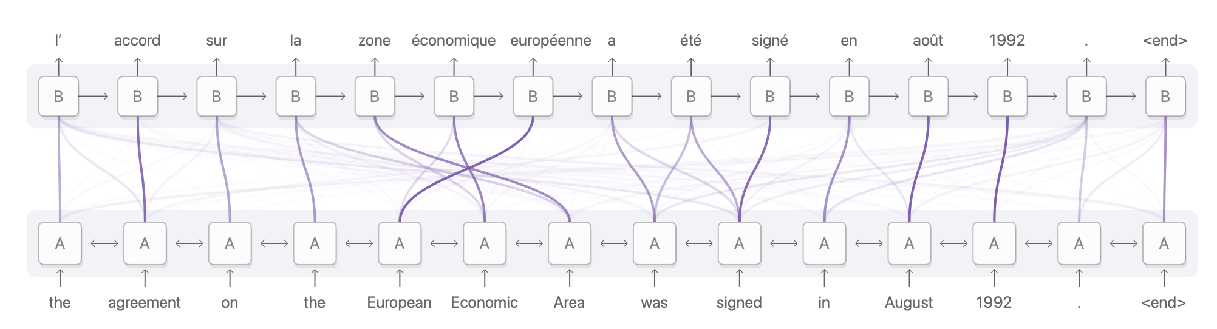

Visualization of Machine Translation
https://distill.pub/2016/augmented-rnns/

Slide 35
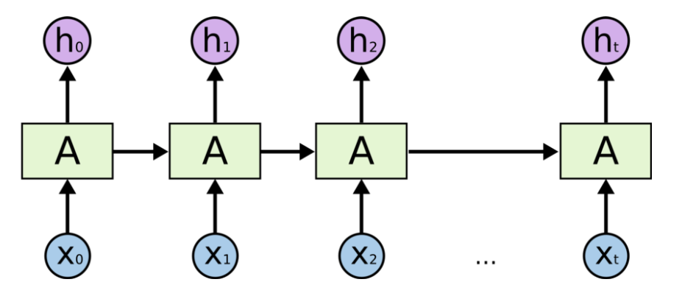
RNN

Slide 36
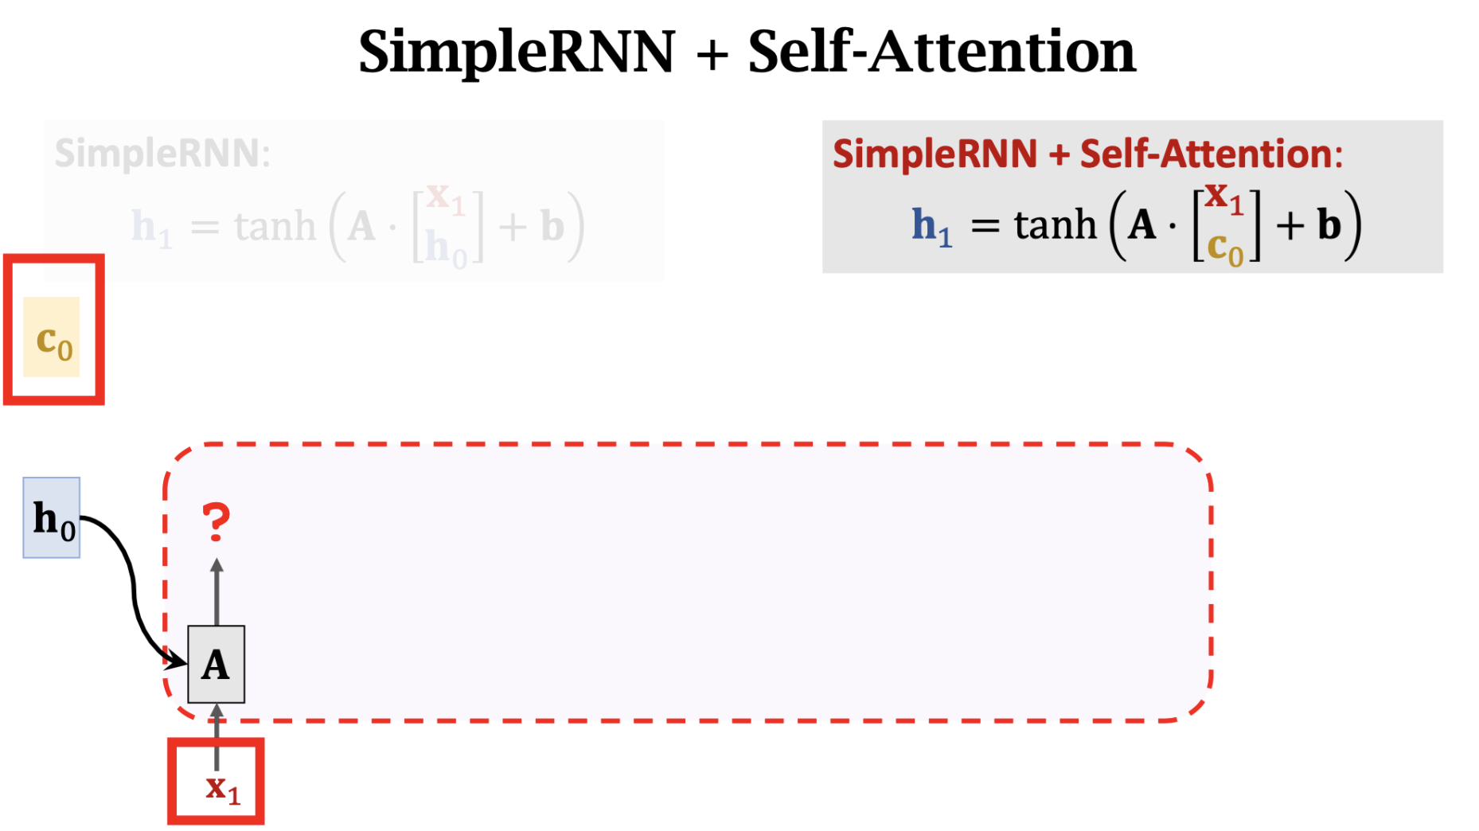

Slide 37
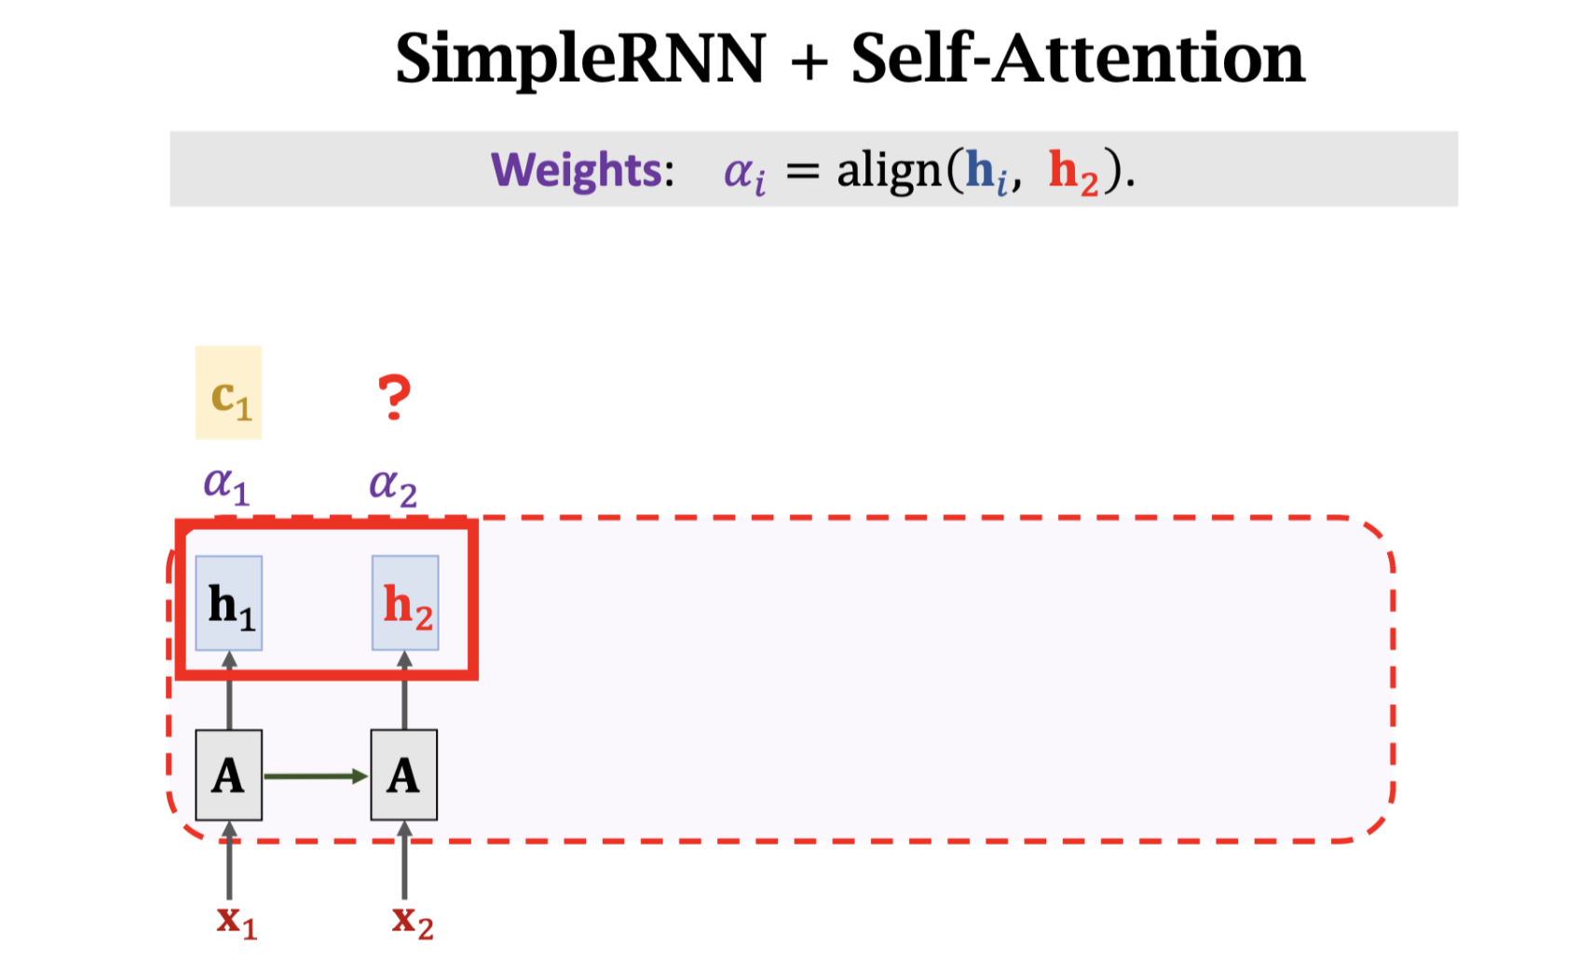
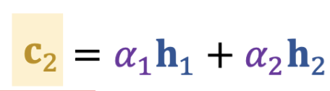
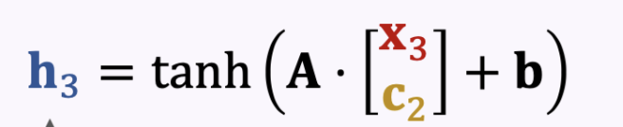

Slide 38
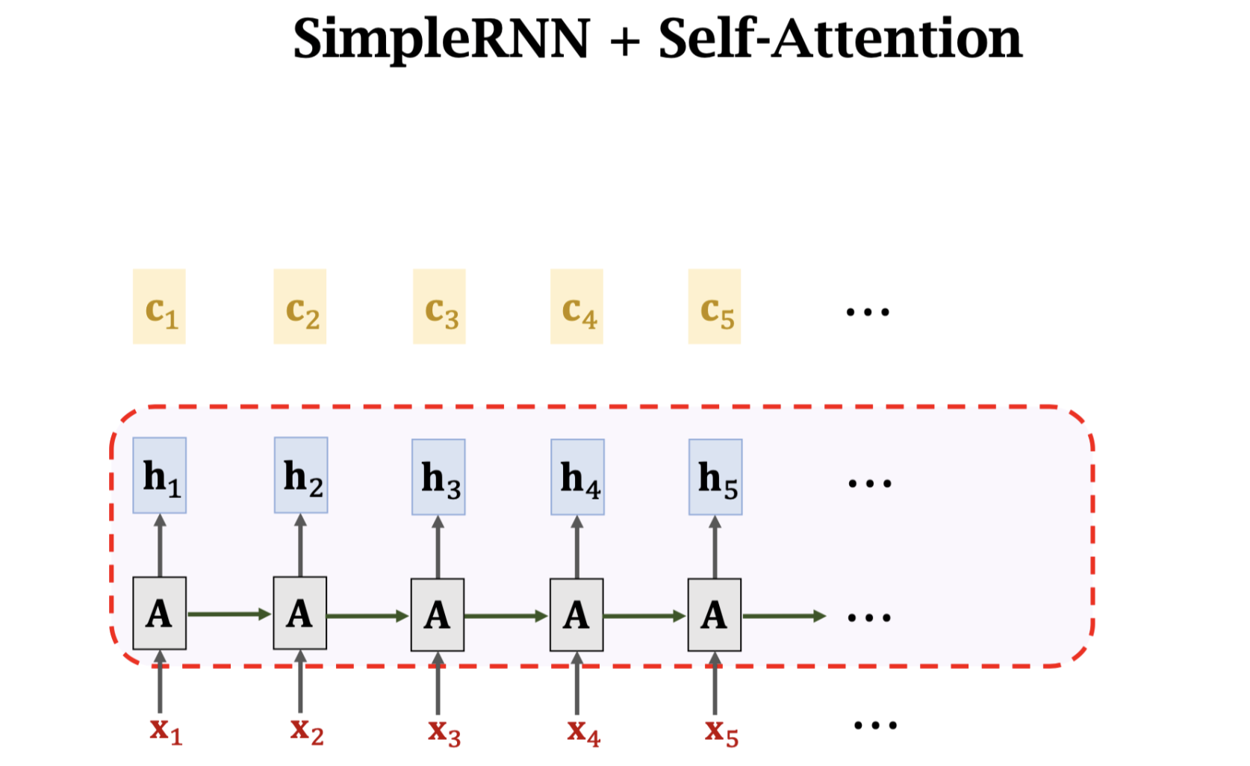

Slide 39
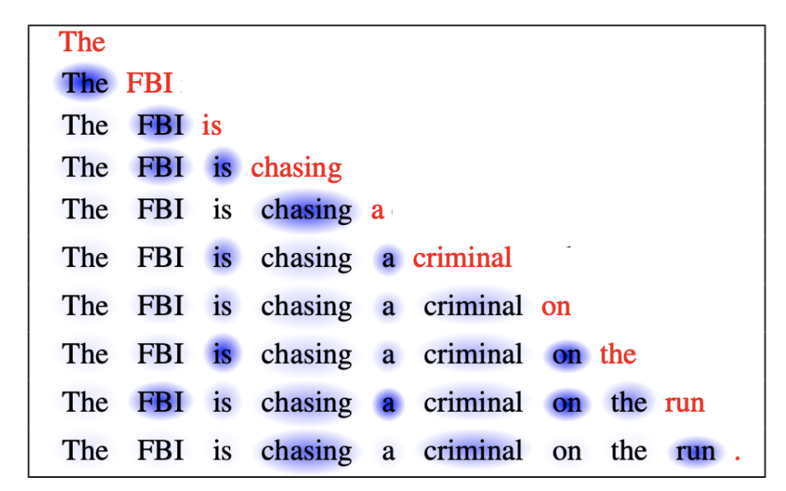

Slide 40
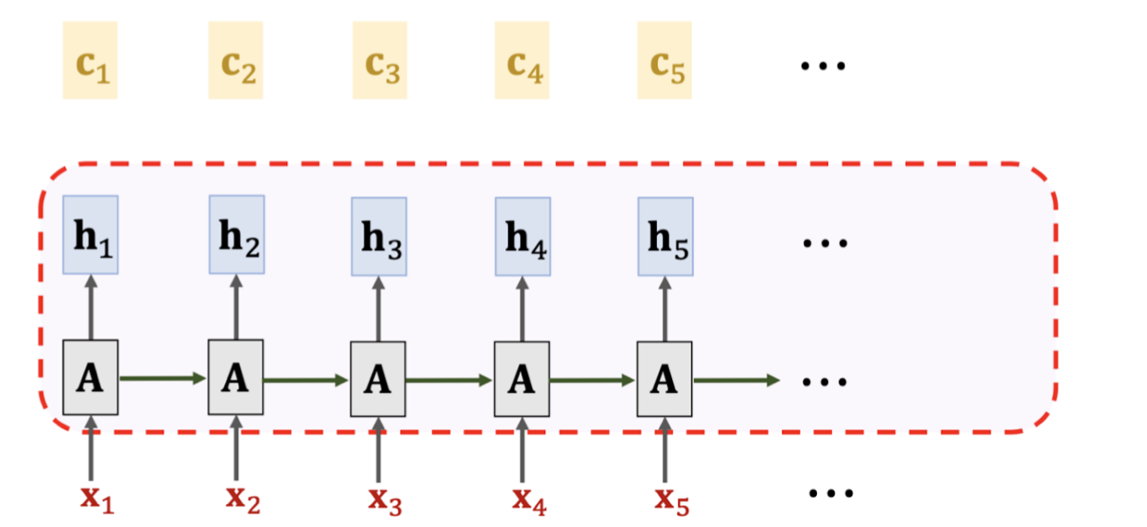
Attention
Self-Attention

Slide 41
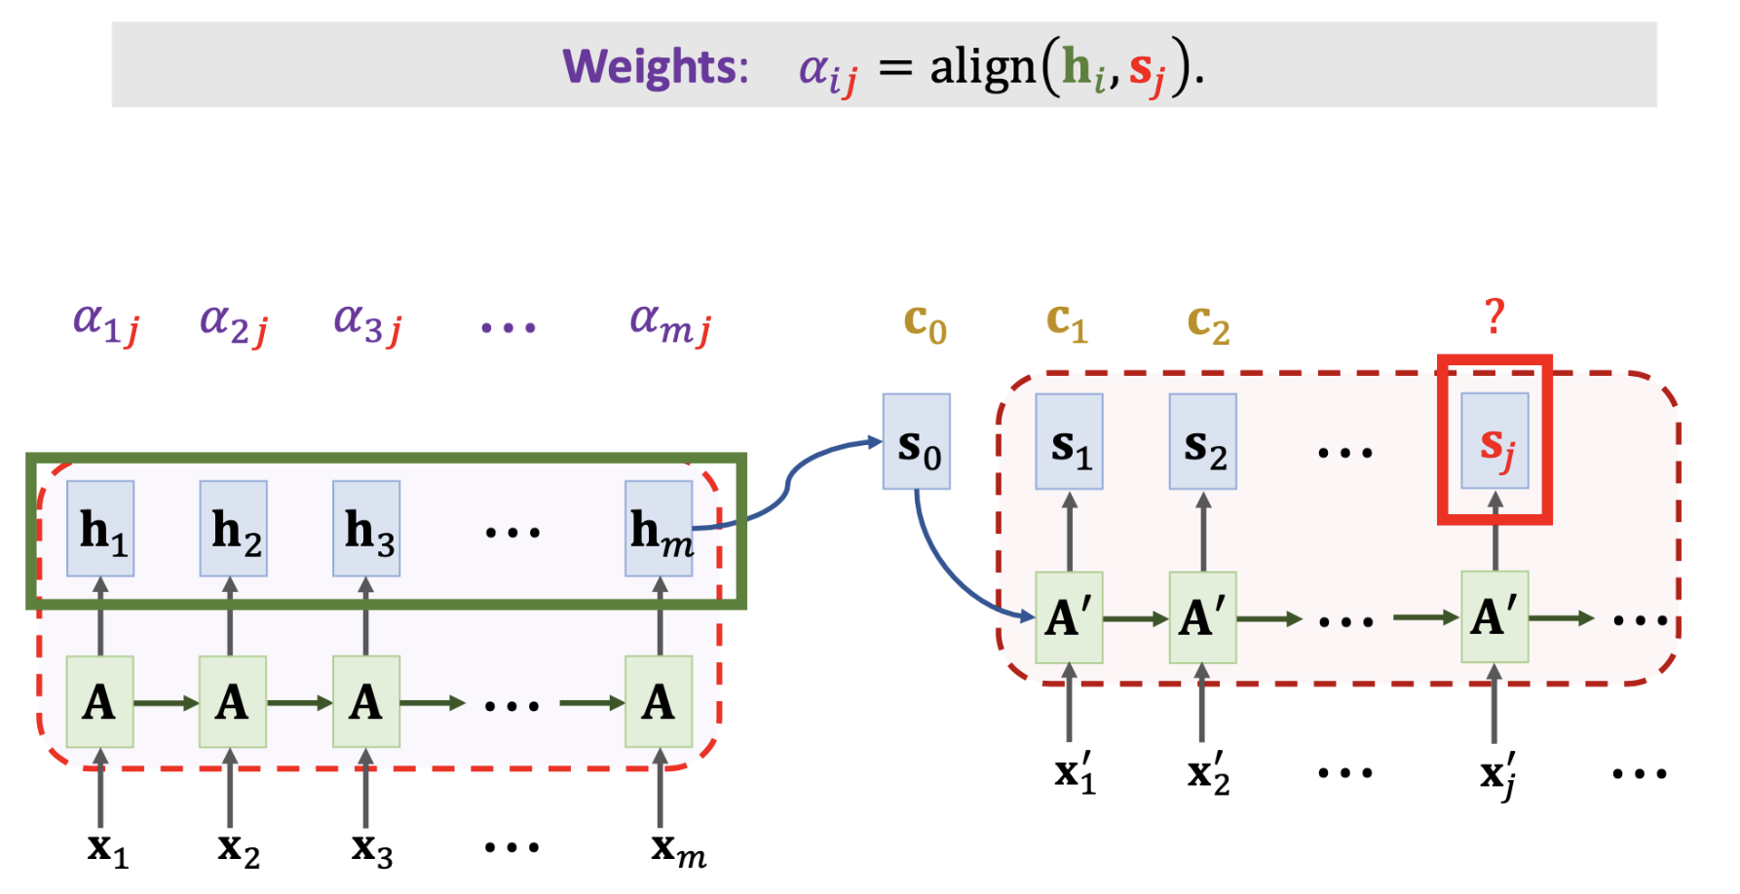
Attention for Seq2Seq Model

Slide 42
align()

Slide 43
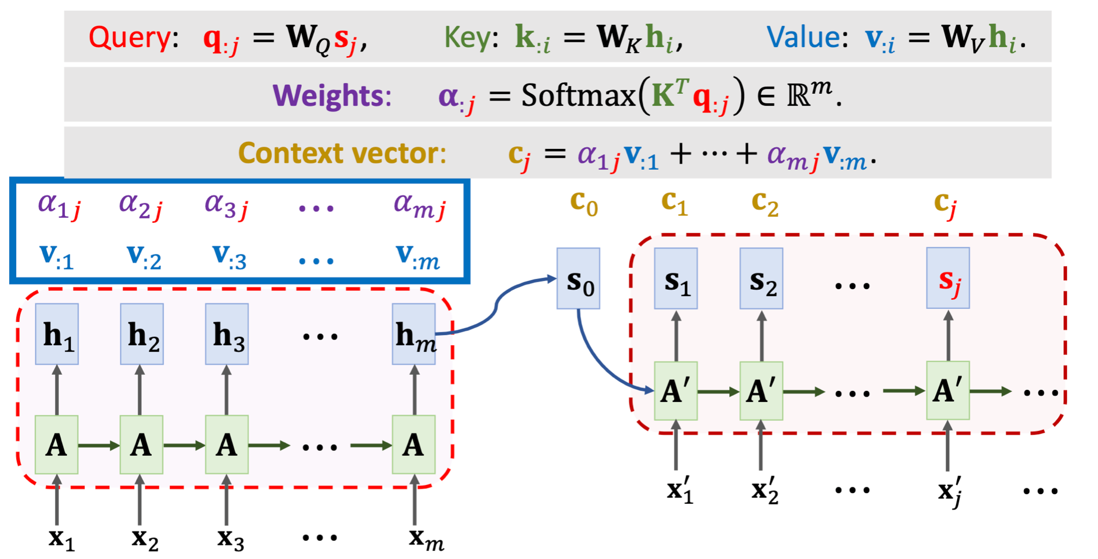

Slide 44
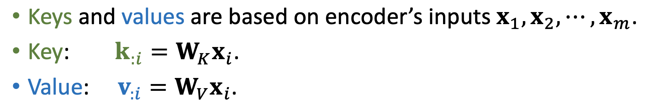
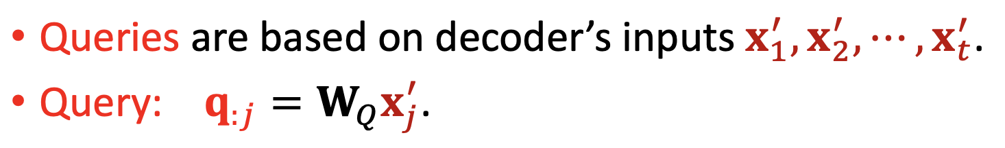
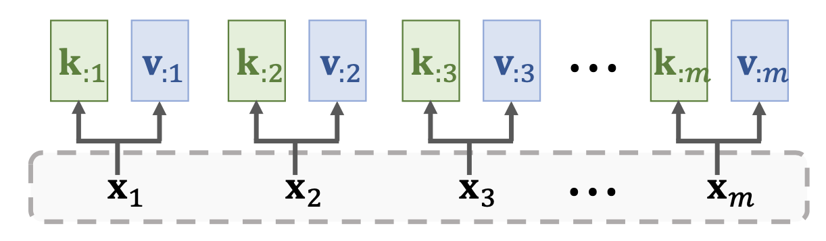
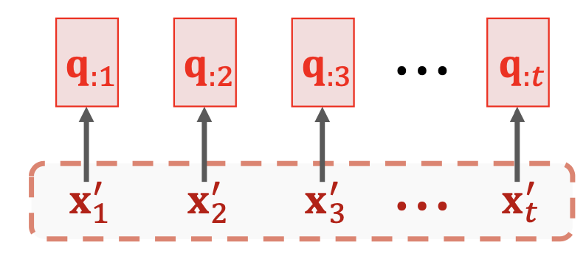
Attention without RNN

Slide 45
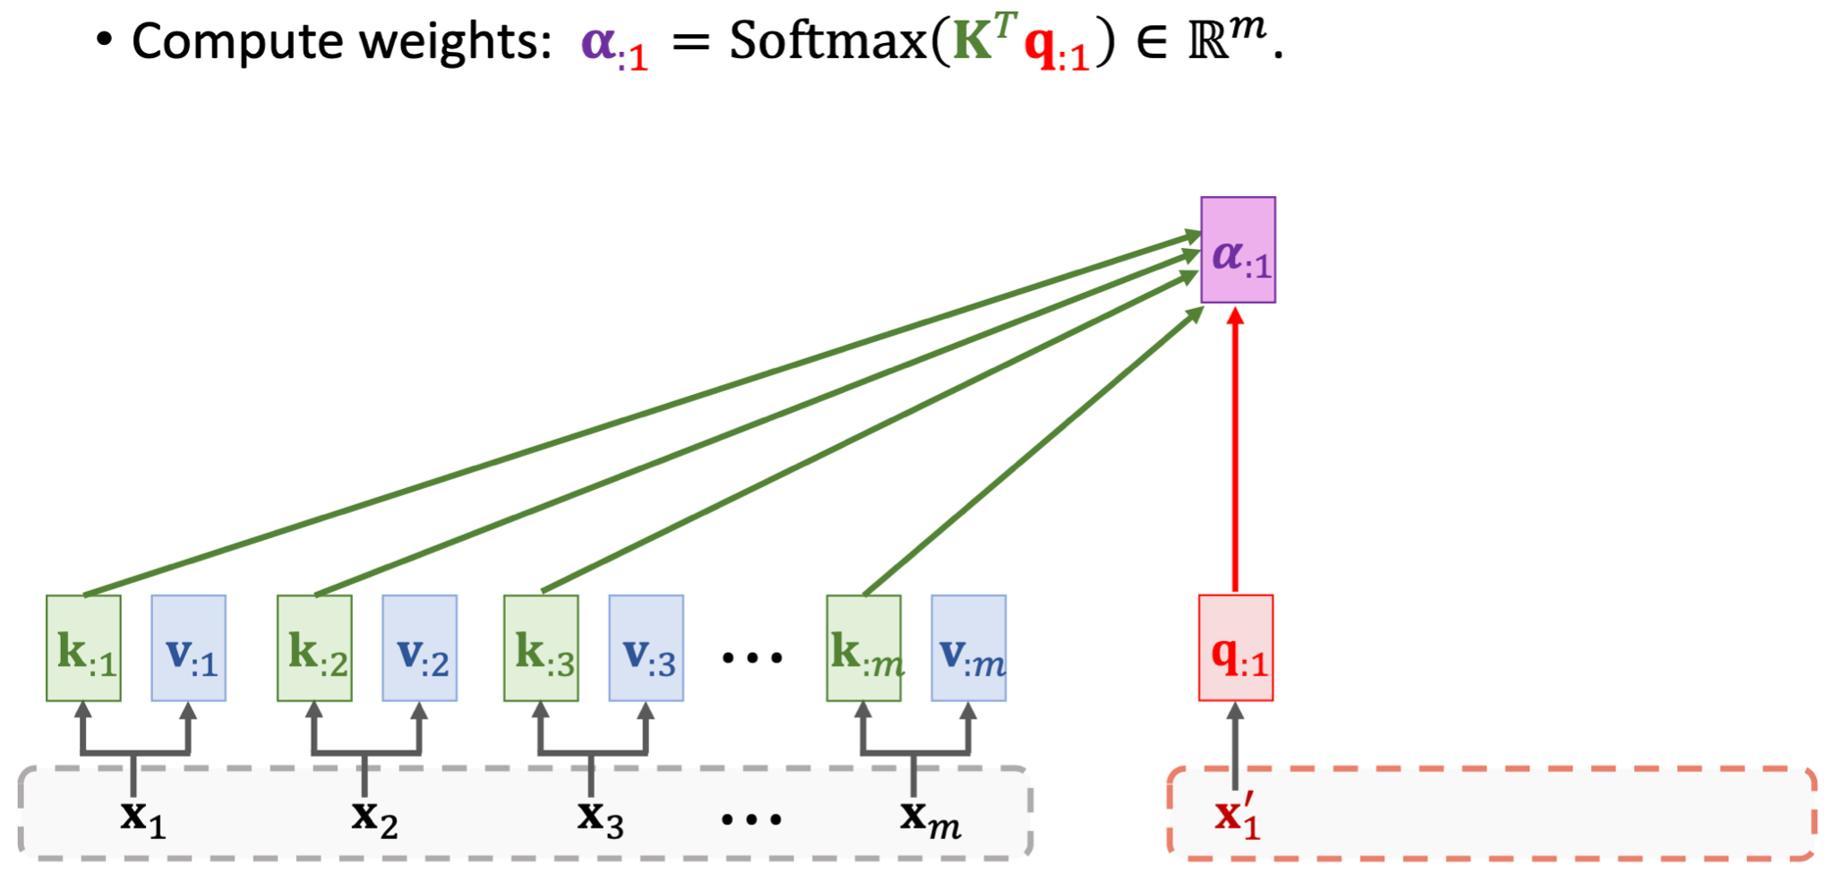

Slide 46
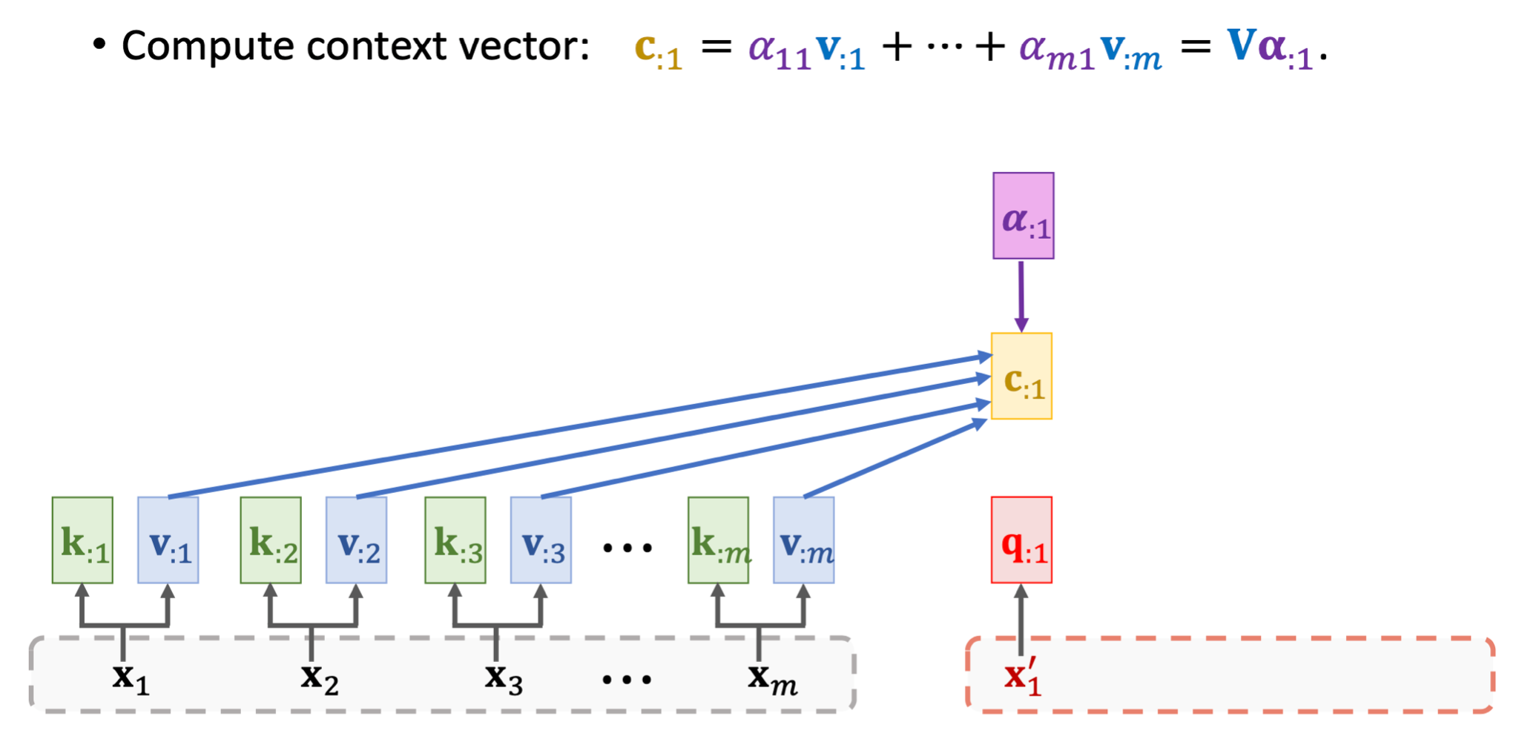

Slide 47
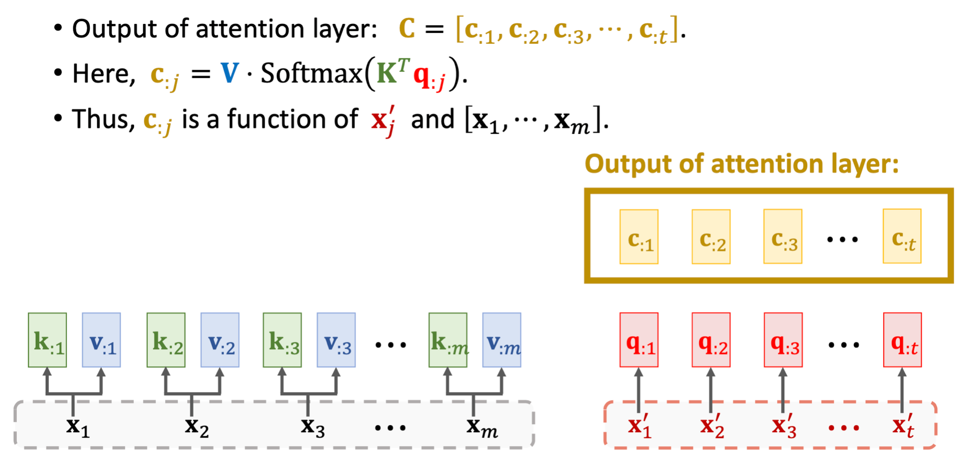

Slide 48
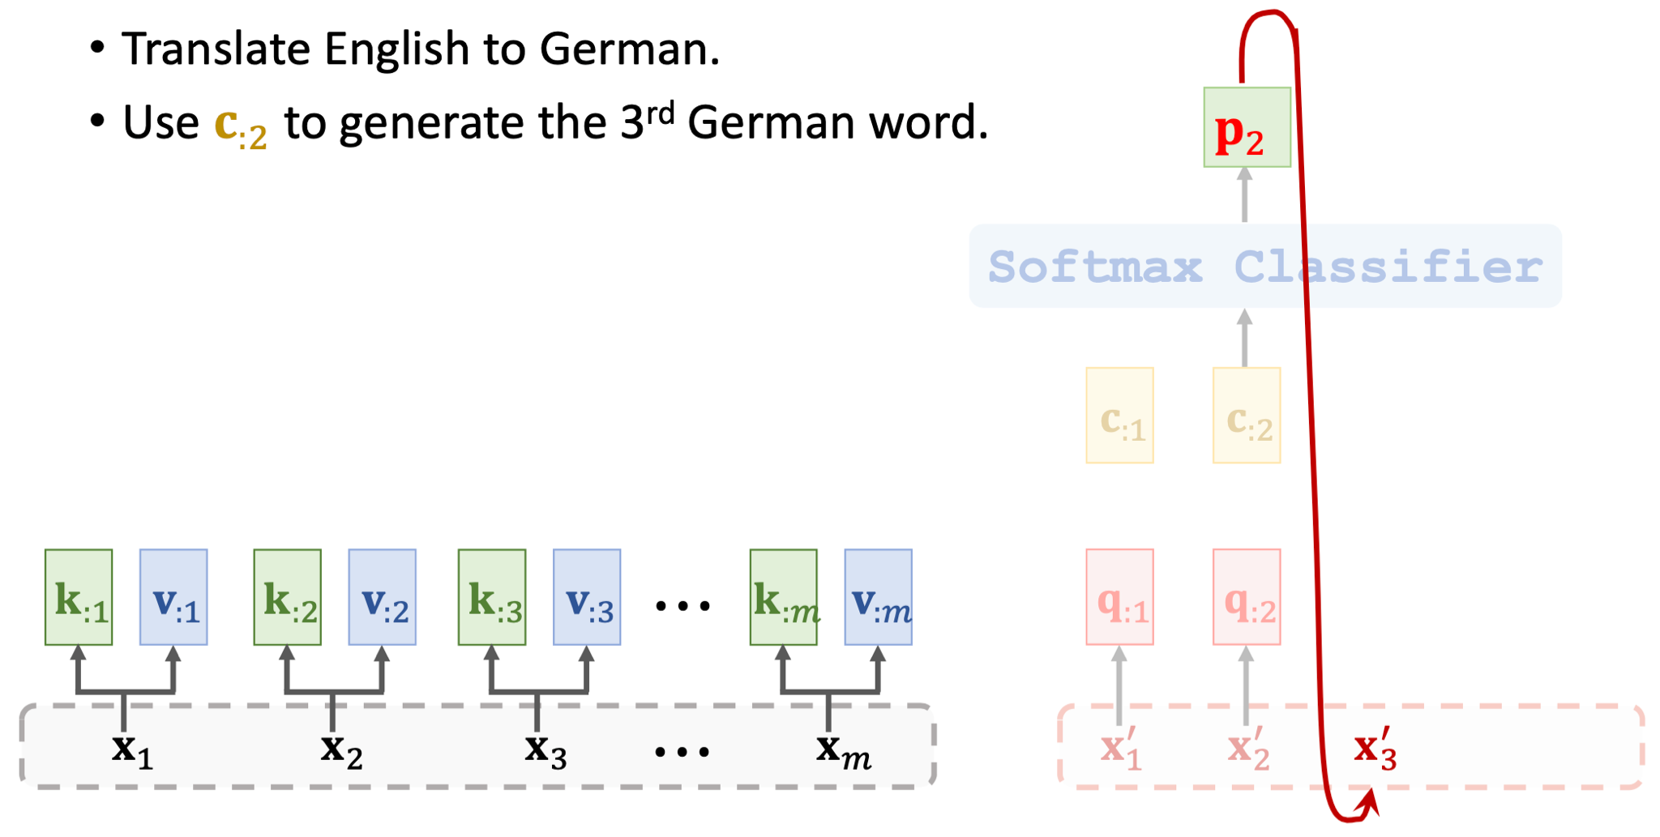

Slide 49
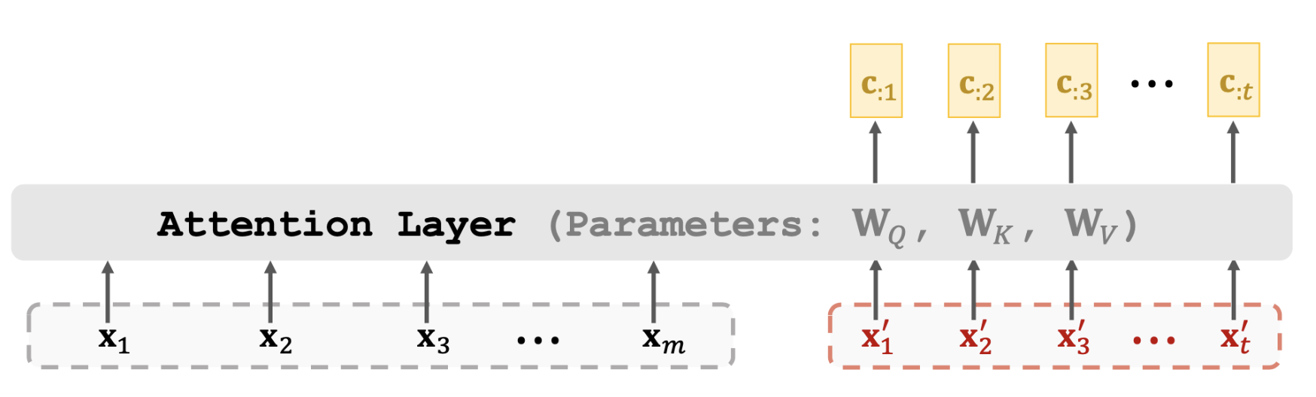
Attention without RNN

Slide 51
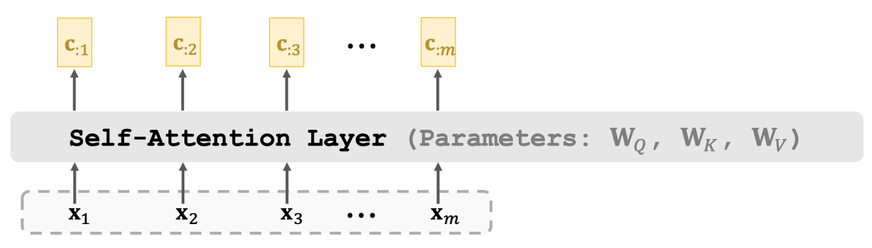
Self-Attention without RNN

Slide 52
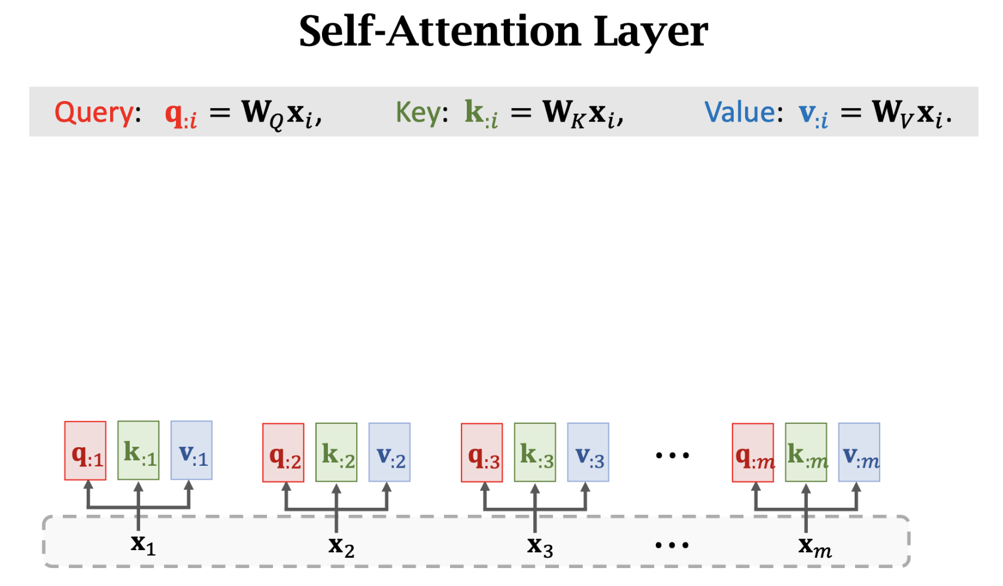

Slide 53


Slide 54


Slide 55


Attention and Self-Attention

Slide 56


Slide 57



Slide 58


Slide 59


Slide 60


Slide 61


Transformer’s Encoder

Slide 62


Slide 63


Slide 64


Slide 65
Transformer
Seq2Seq
Attention and Self-Attention
Attention and Self-Attention without RNN
Multi-head Attention and Multi-head Self-Attention

Slide 66
Bidirectional Encoder Representations from Transformers (BERT)
BERT is for pre-training Transformer’s encoder.

Slide 67

Predict masked words

Slide 68

Predict the next sentence

Slide 69

Predict the next sentence

Slide 70

Vision Transformer

Slide 71


Split image into patches

Slide 72

Vectorization

Slide 73



Slide 74


Slide 75


Slide 76


Slide 77
Thank you!

